Slide 1



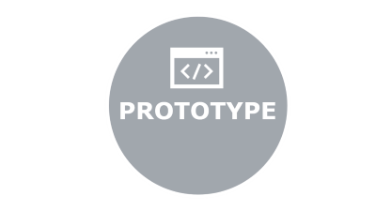

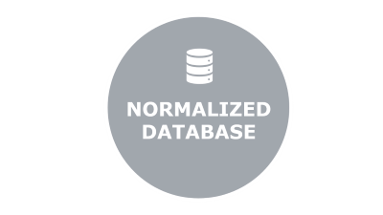
RAILWAY RESERVATION SYSTEM
Done By
. Rakhul Prakash SB
(220701216)
. Sabarish M
(220701234)

Slide 2

ABSTRACT

Slide 3




ABSTRACT
This project involves the creation of a Railway Ticket Booking System utilizing Python, Streamlit, and MySQL, with a focus on database normalization concepts. The system features a user-friendly interface built with Streamlit, allowing users to register, search for trains, book tickets, and manage their bookings seamlessly. Python handles the backend logic, ensuring robust and scalable functionality. MySQL is used for the relational database, where normalization techniques up to the third normal form (3NF) are implemented to optimize the database structure, eliminate redundancy, and maintain data integrity.
ABSTRACT

Slide 4

FEATURES

Slide 5




FEATURES
Secure login and signup
Easy Ticket booking
View the ticket
Cancel the ticket
Admin Panel
Database management
Tech Stack :
ABSTRACT

Slide 6

ER DIAGRAM

Slide 7
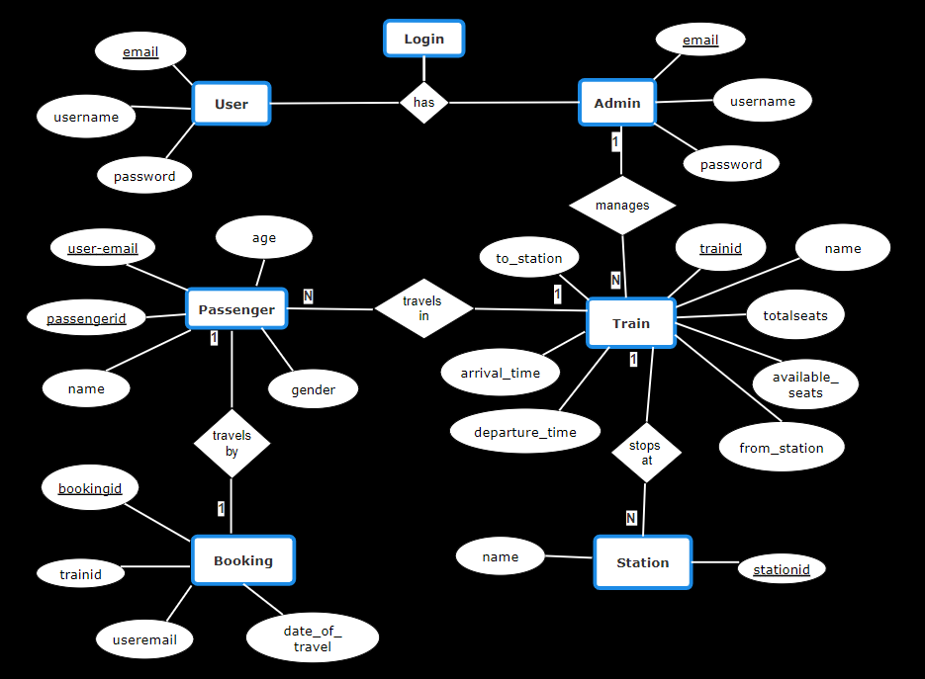
ER DIAGRAM
ABSTRACT

Slide 8

PROTOTYPE

Slide 9
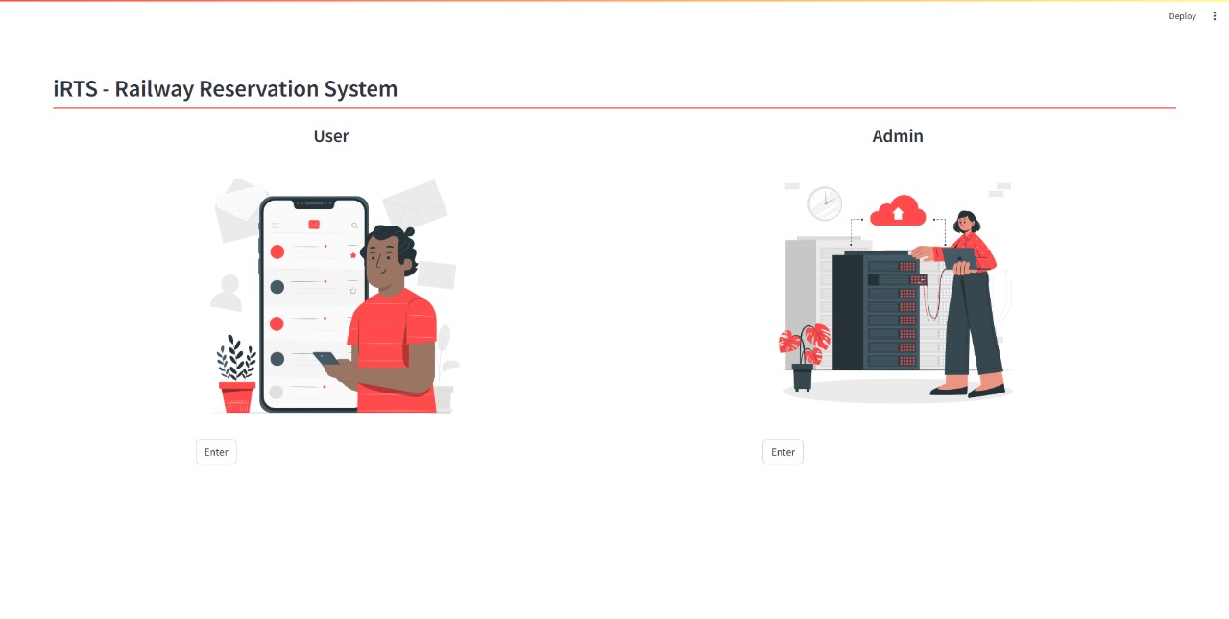
PROTOTYPE
Pre-Login page :

Slide 10
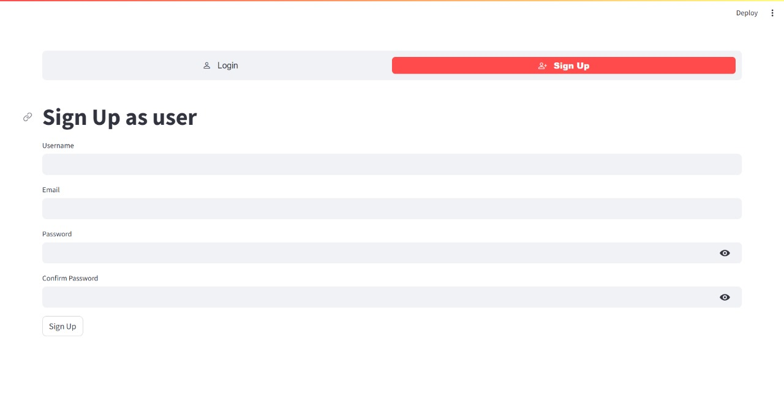
PROTOTYPE
Sign up page :

Slide 11
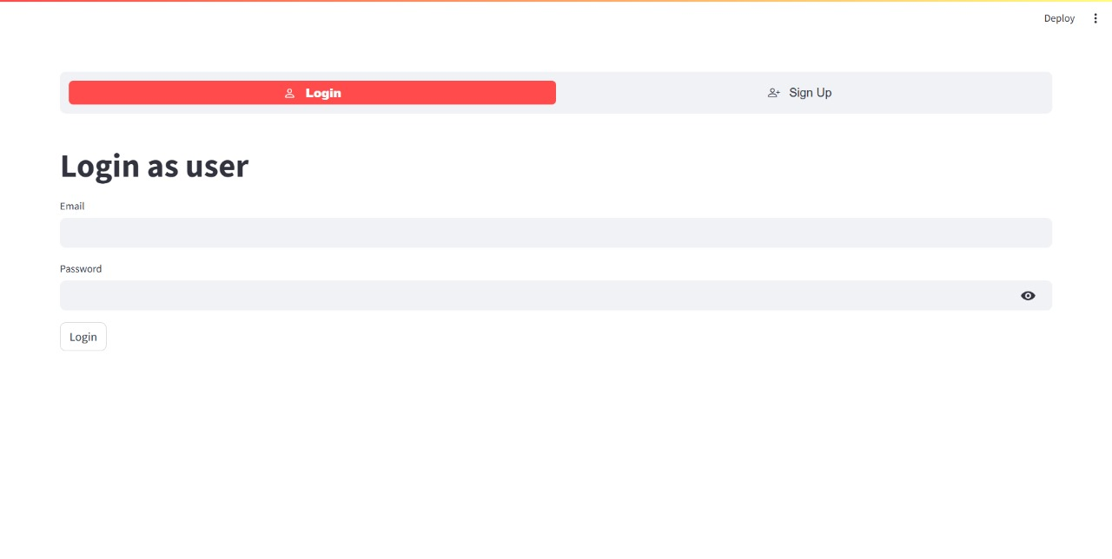
PROTOTYPE
Login page :

Slide 12
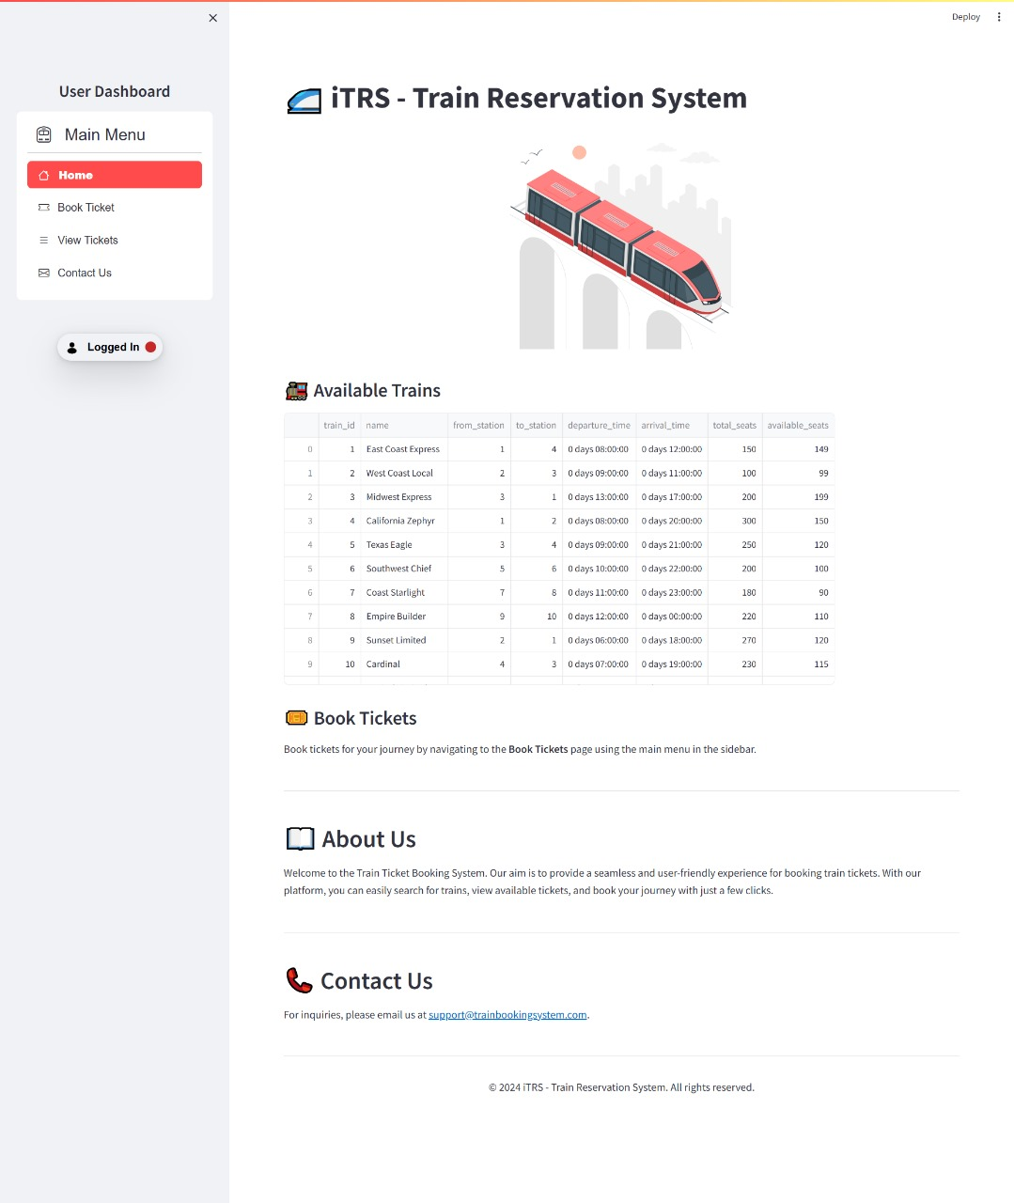
PROTOTYPE
Home page :

Slide 13
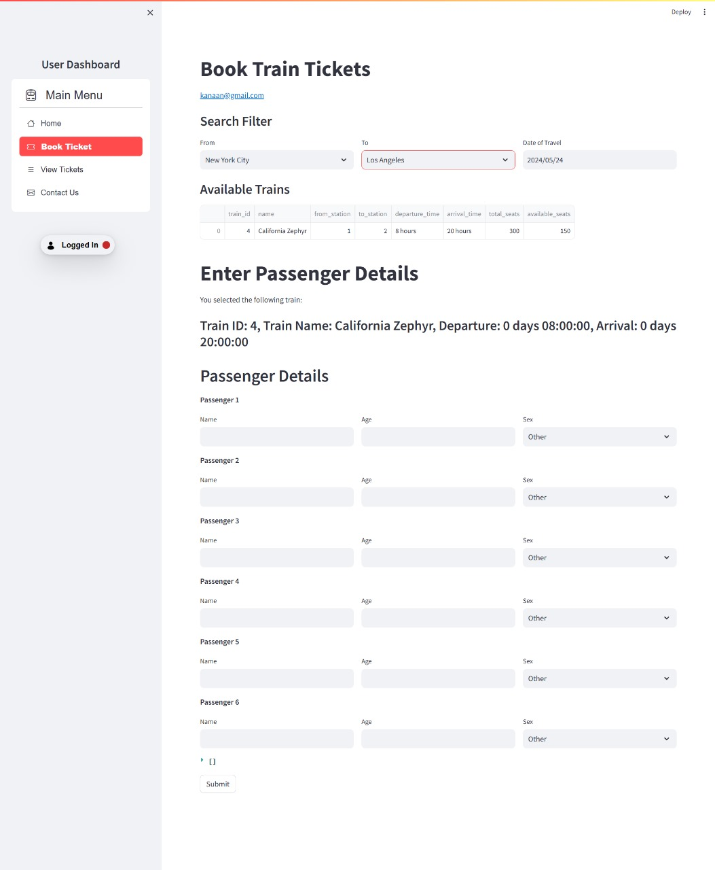
PROTOTYPE
Booking page :

Slide 14

NORMALIZED DATABASE

Slide 15
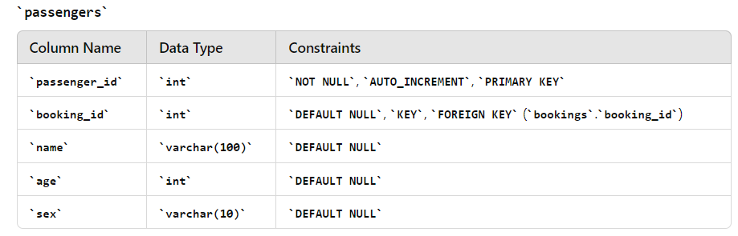
NORMALIZED DATABASE
TABLES :
ABSTRACT

Slide 16
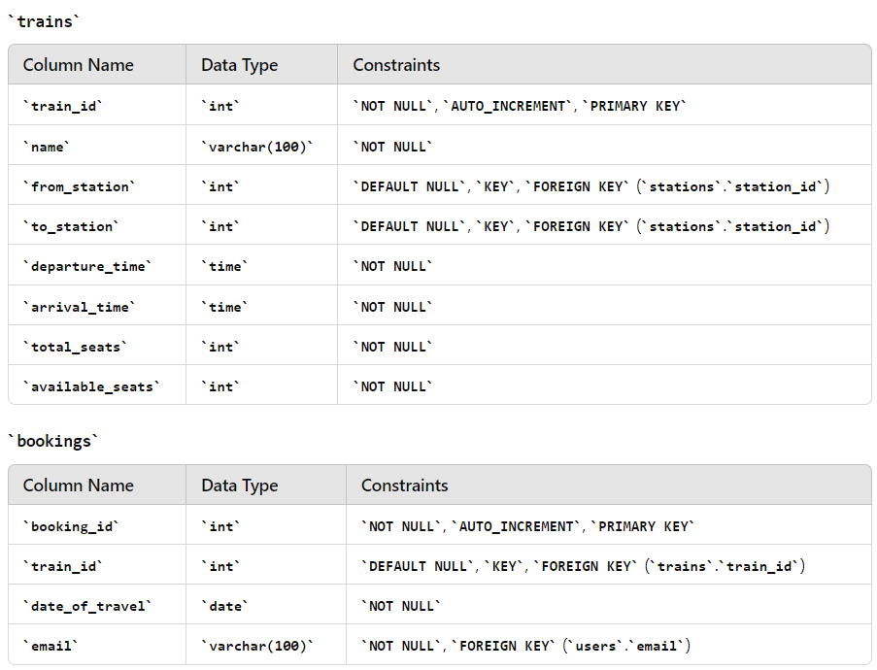
ABSTRACT

Slide 17
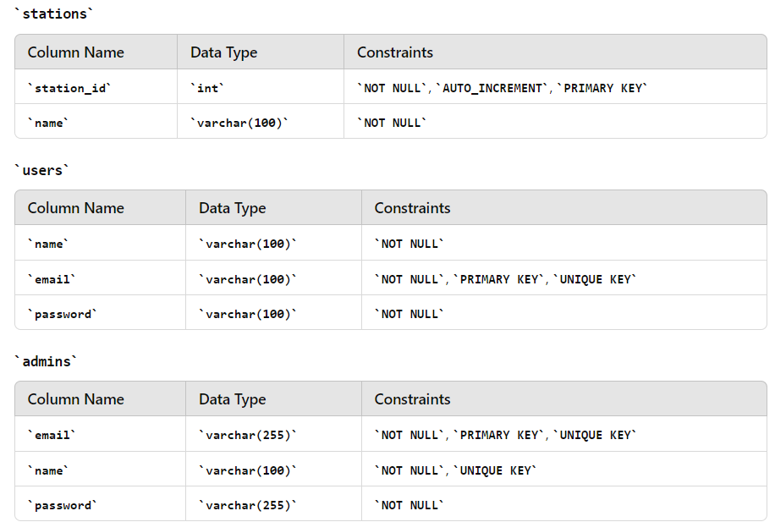
ABSTRACT

